Slide 1

IDILIO THE ARTISTIC ELYSIUM
INTERIM PRESENTATION
S17522
H.D.T.HAPANGAMA

Slide 2
Content
Introduction to the problem
Approach
Progress

Slide 3



Introduction to the Problem
Problem Statement
Charge extra fees from both the buyer and seller sides.
These Platforms Facilitate Single task
Communication Problems about the graphic projects.
Competition of the online job market.
Less opportunity of working with professional buyers

Slide 4
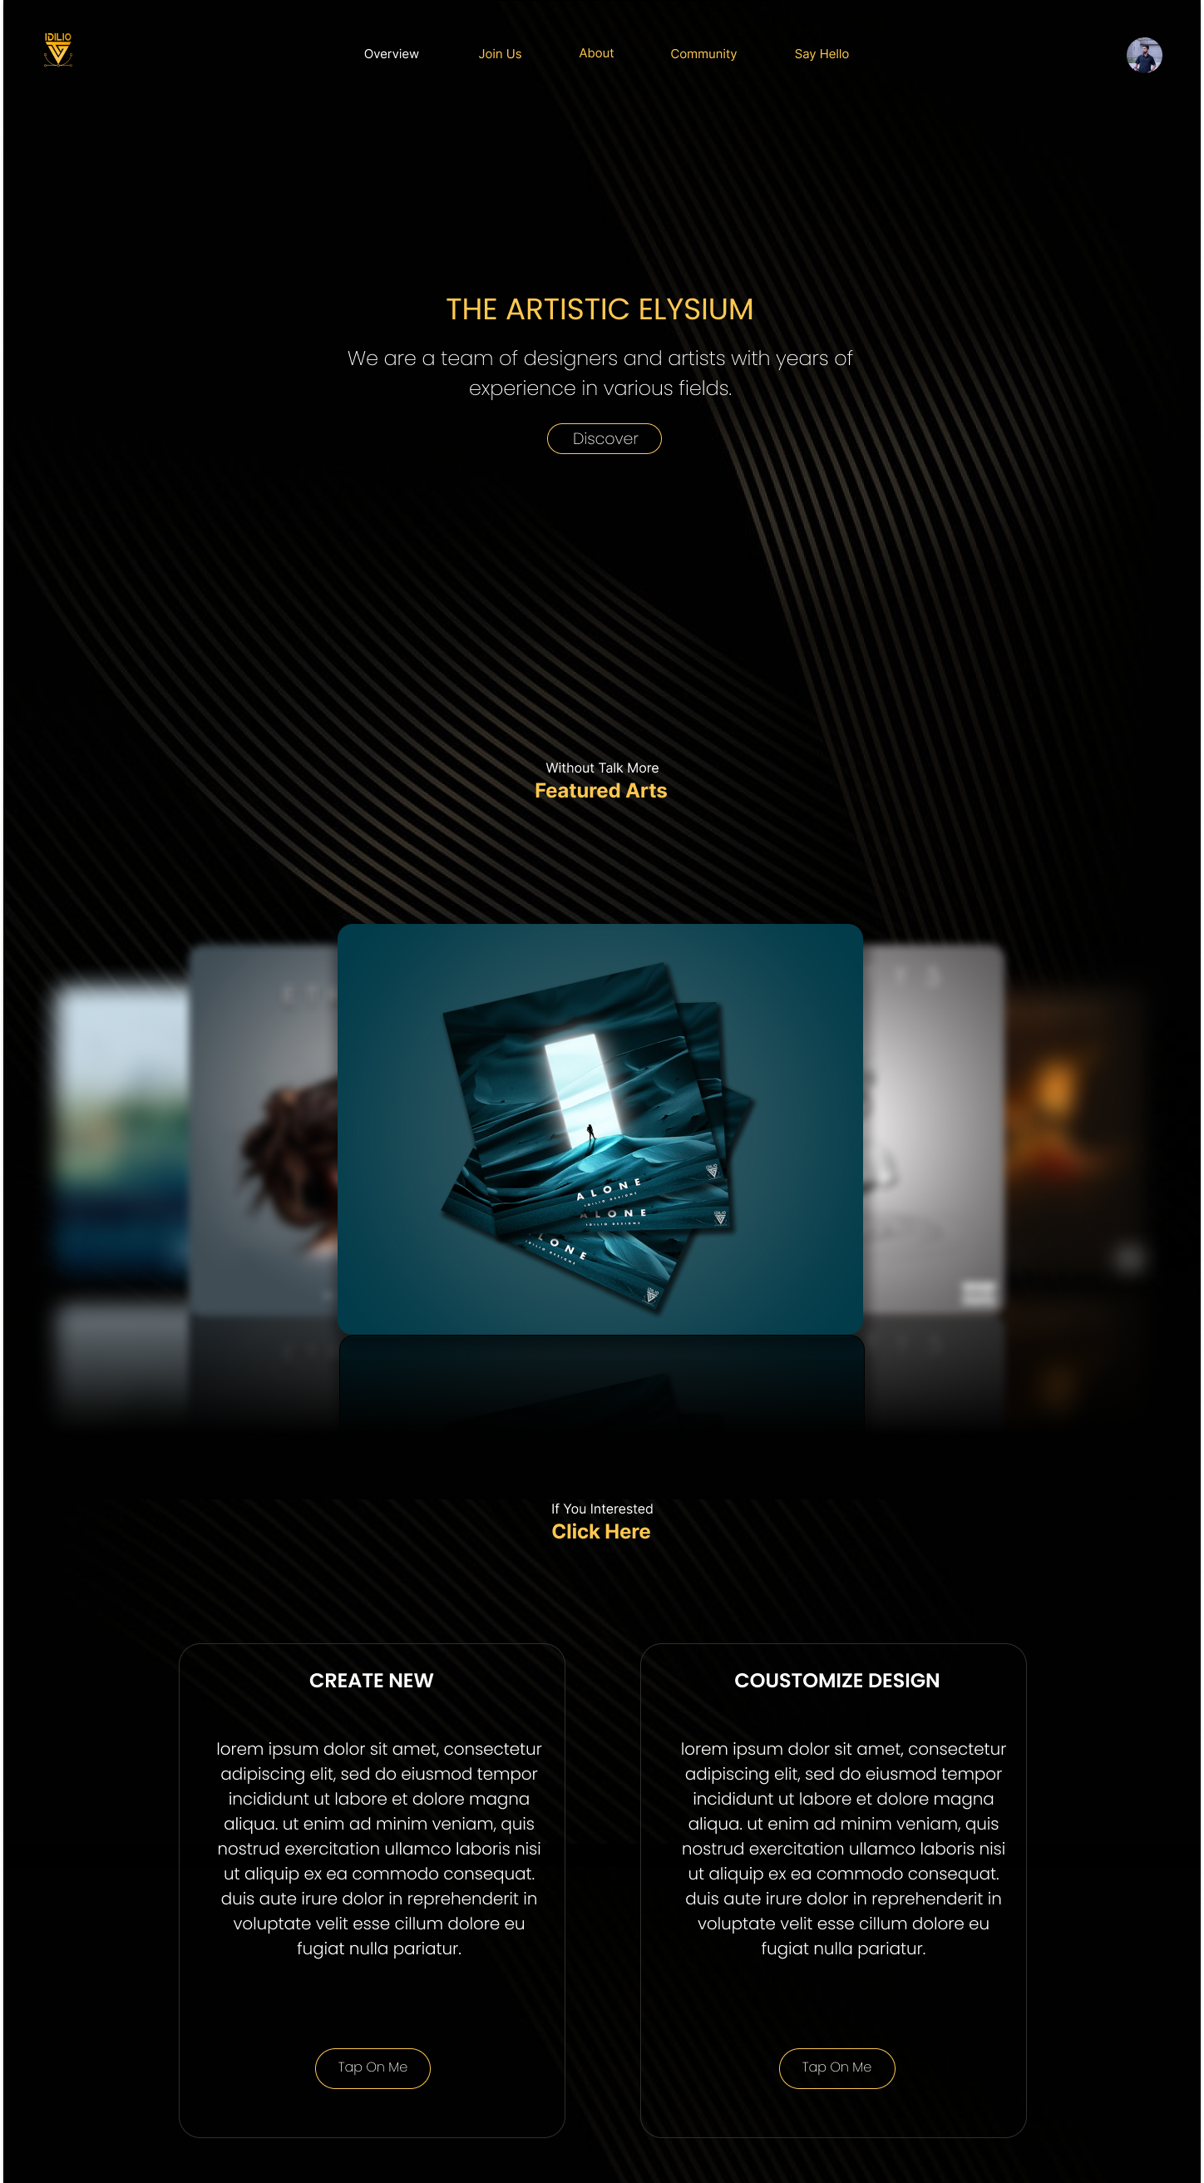
IDILIO
Not Charging Additional Fees.
Offer New & Resource designs form one platform.
Chance for Local Professional Graphic Designers.
Introduce the Whiteboard and the Filter search features.
Control access admin to handle orders with Progress Bar.

Slide 5



Approach and Technologies
Approach
Requirement Analysis
System Design
Implementation
Testing
Maintenance
Technologies
Frontend : React
Backend : Spring Boot
Database : MySQL
Other : VSCode, IntelliJ
Postman

Slide 6
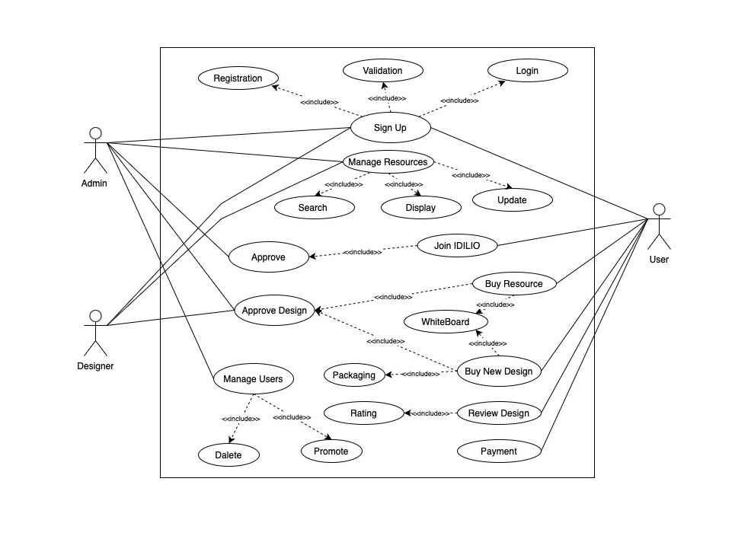
Use Case Diagram

Slide 7
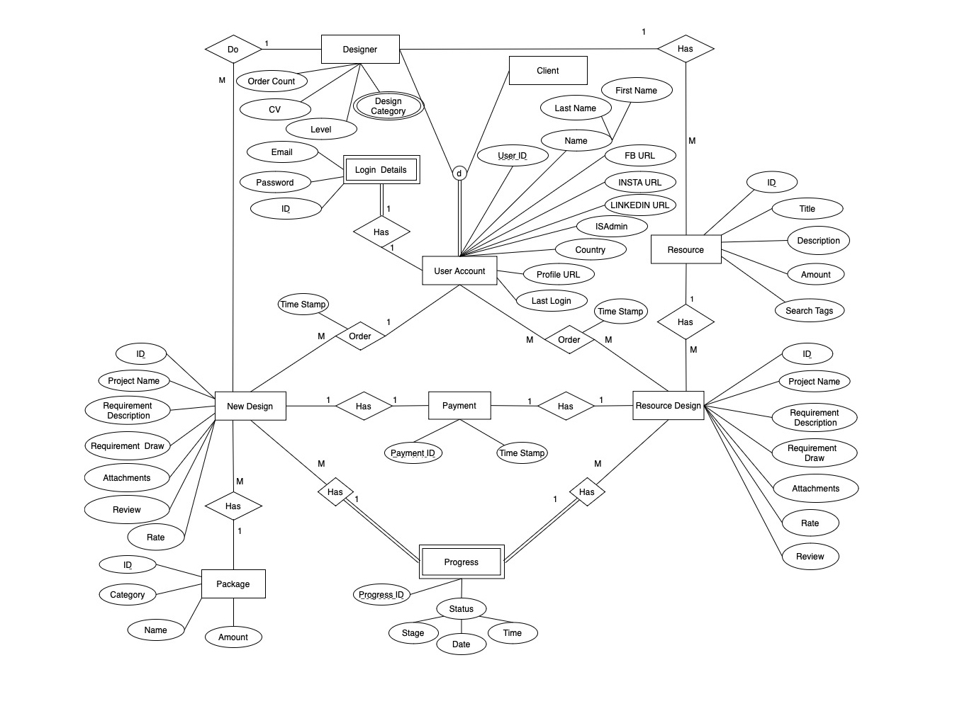
ER Diagram

Slide 8
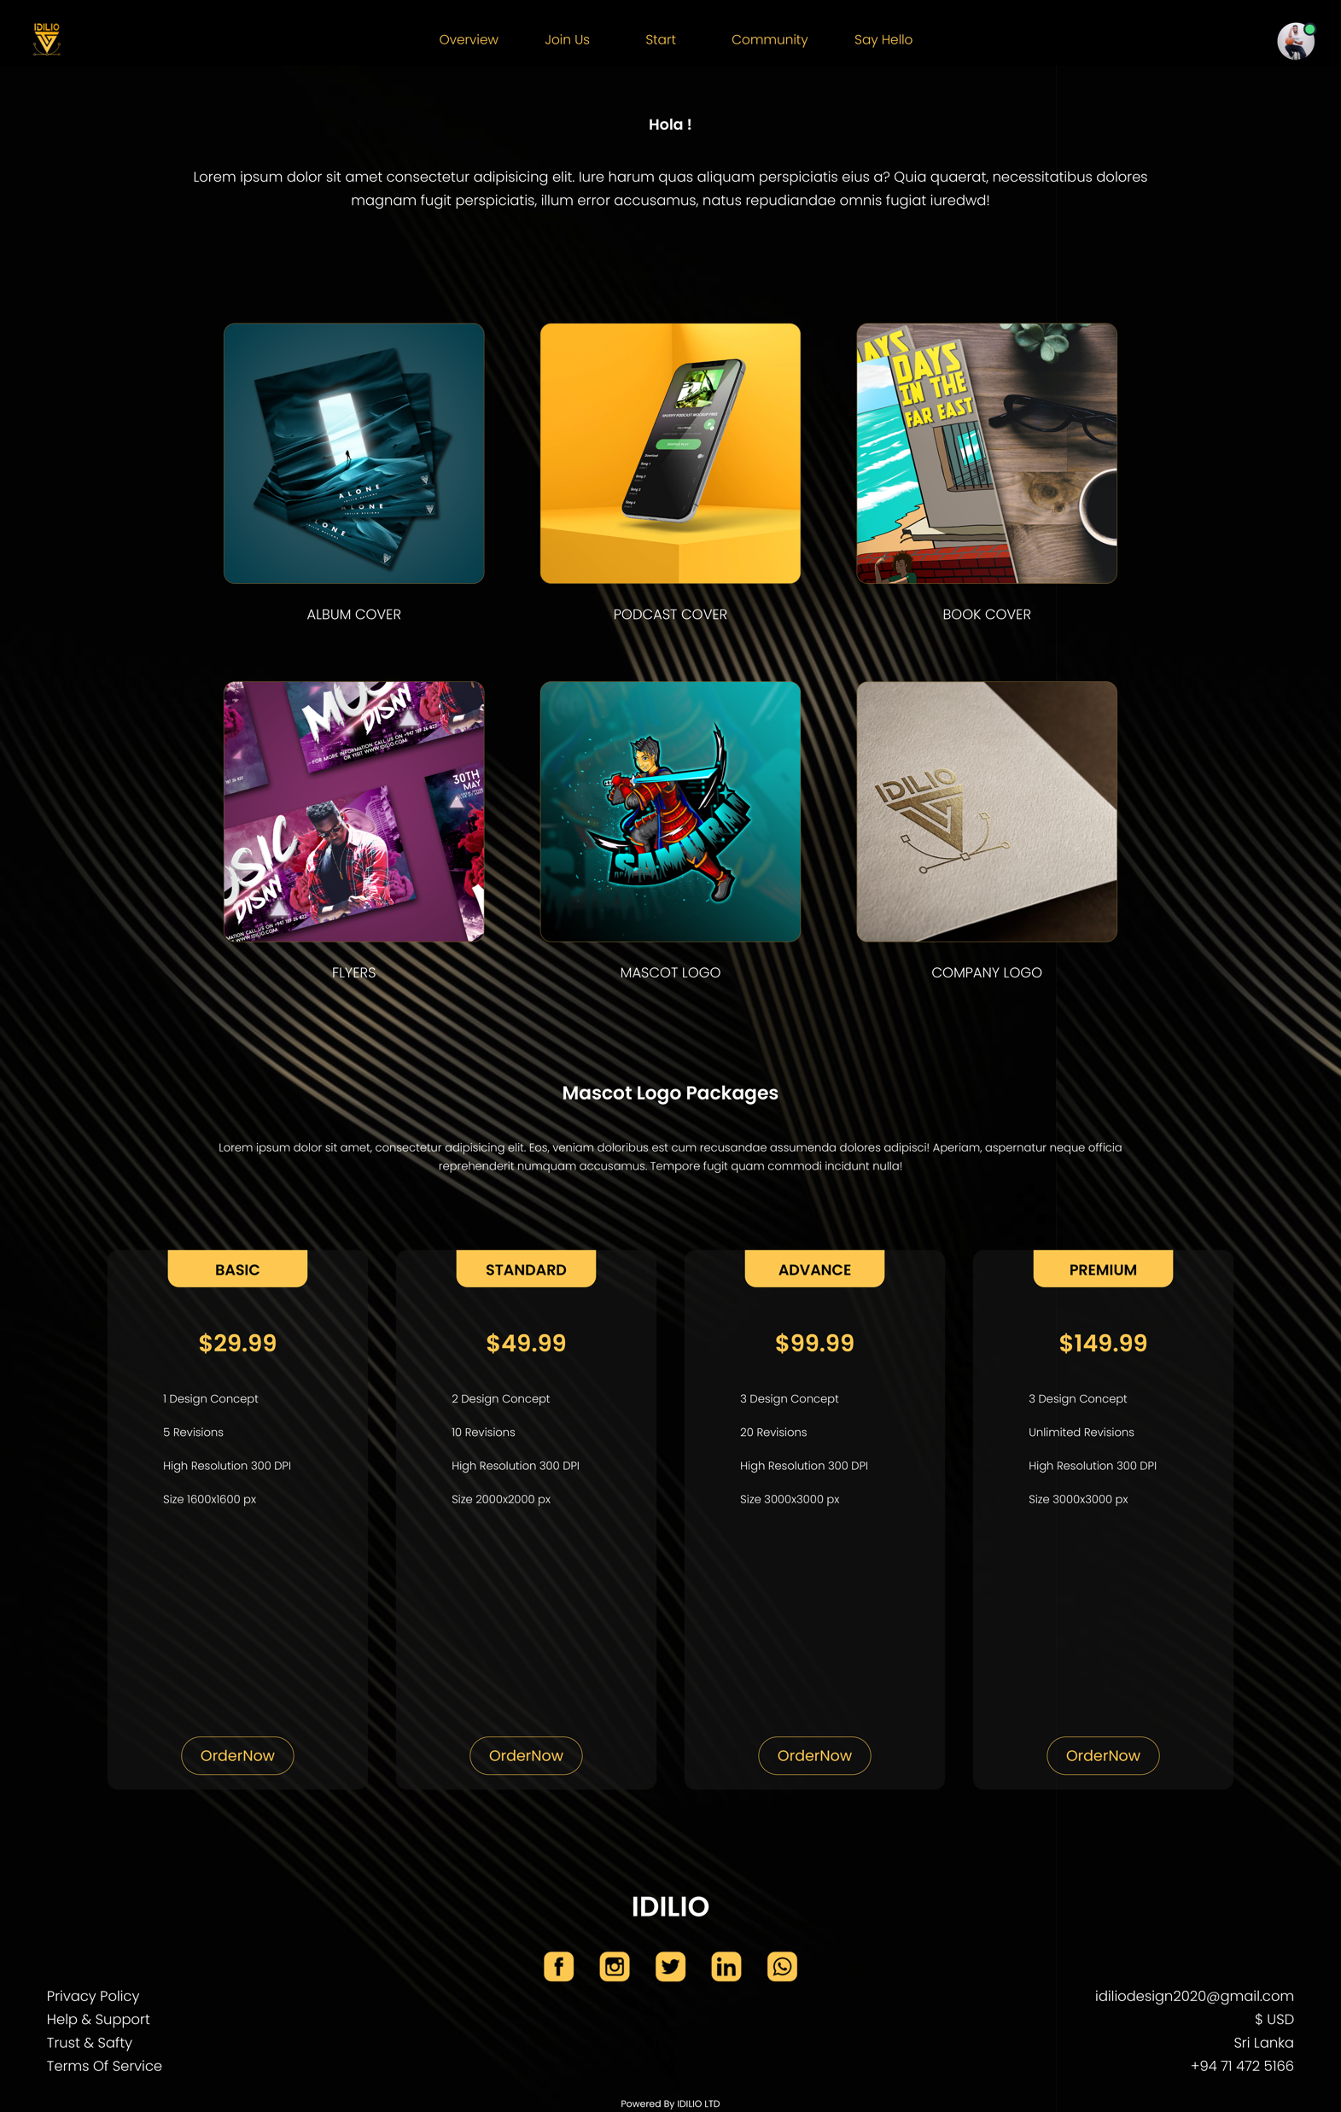
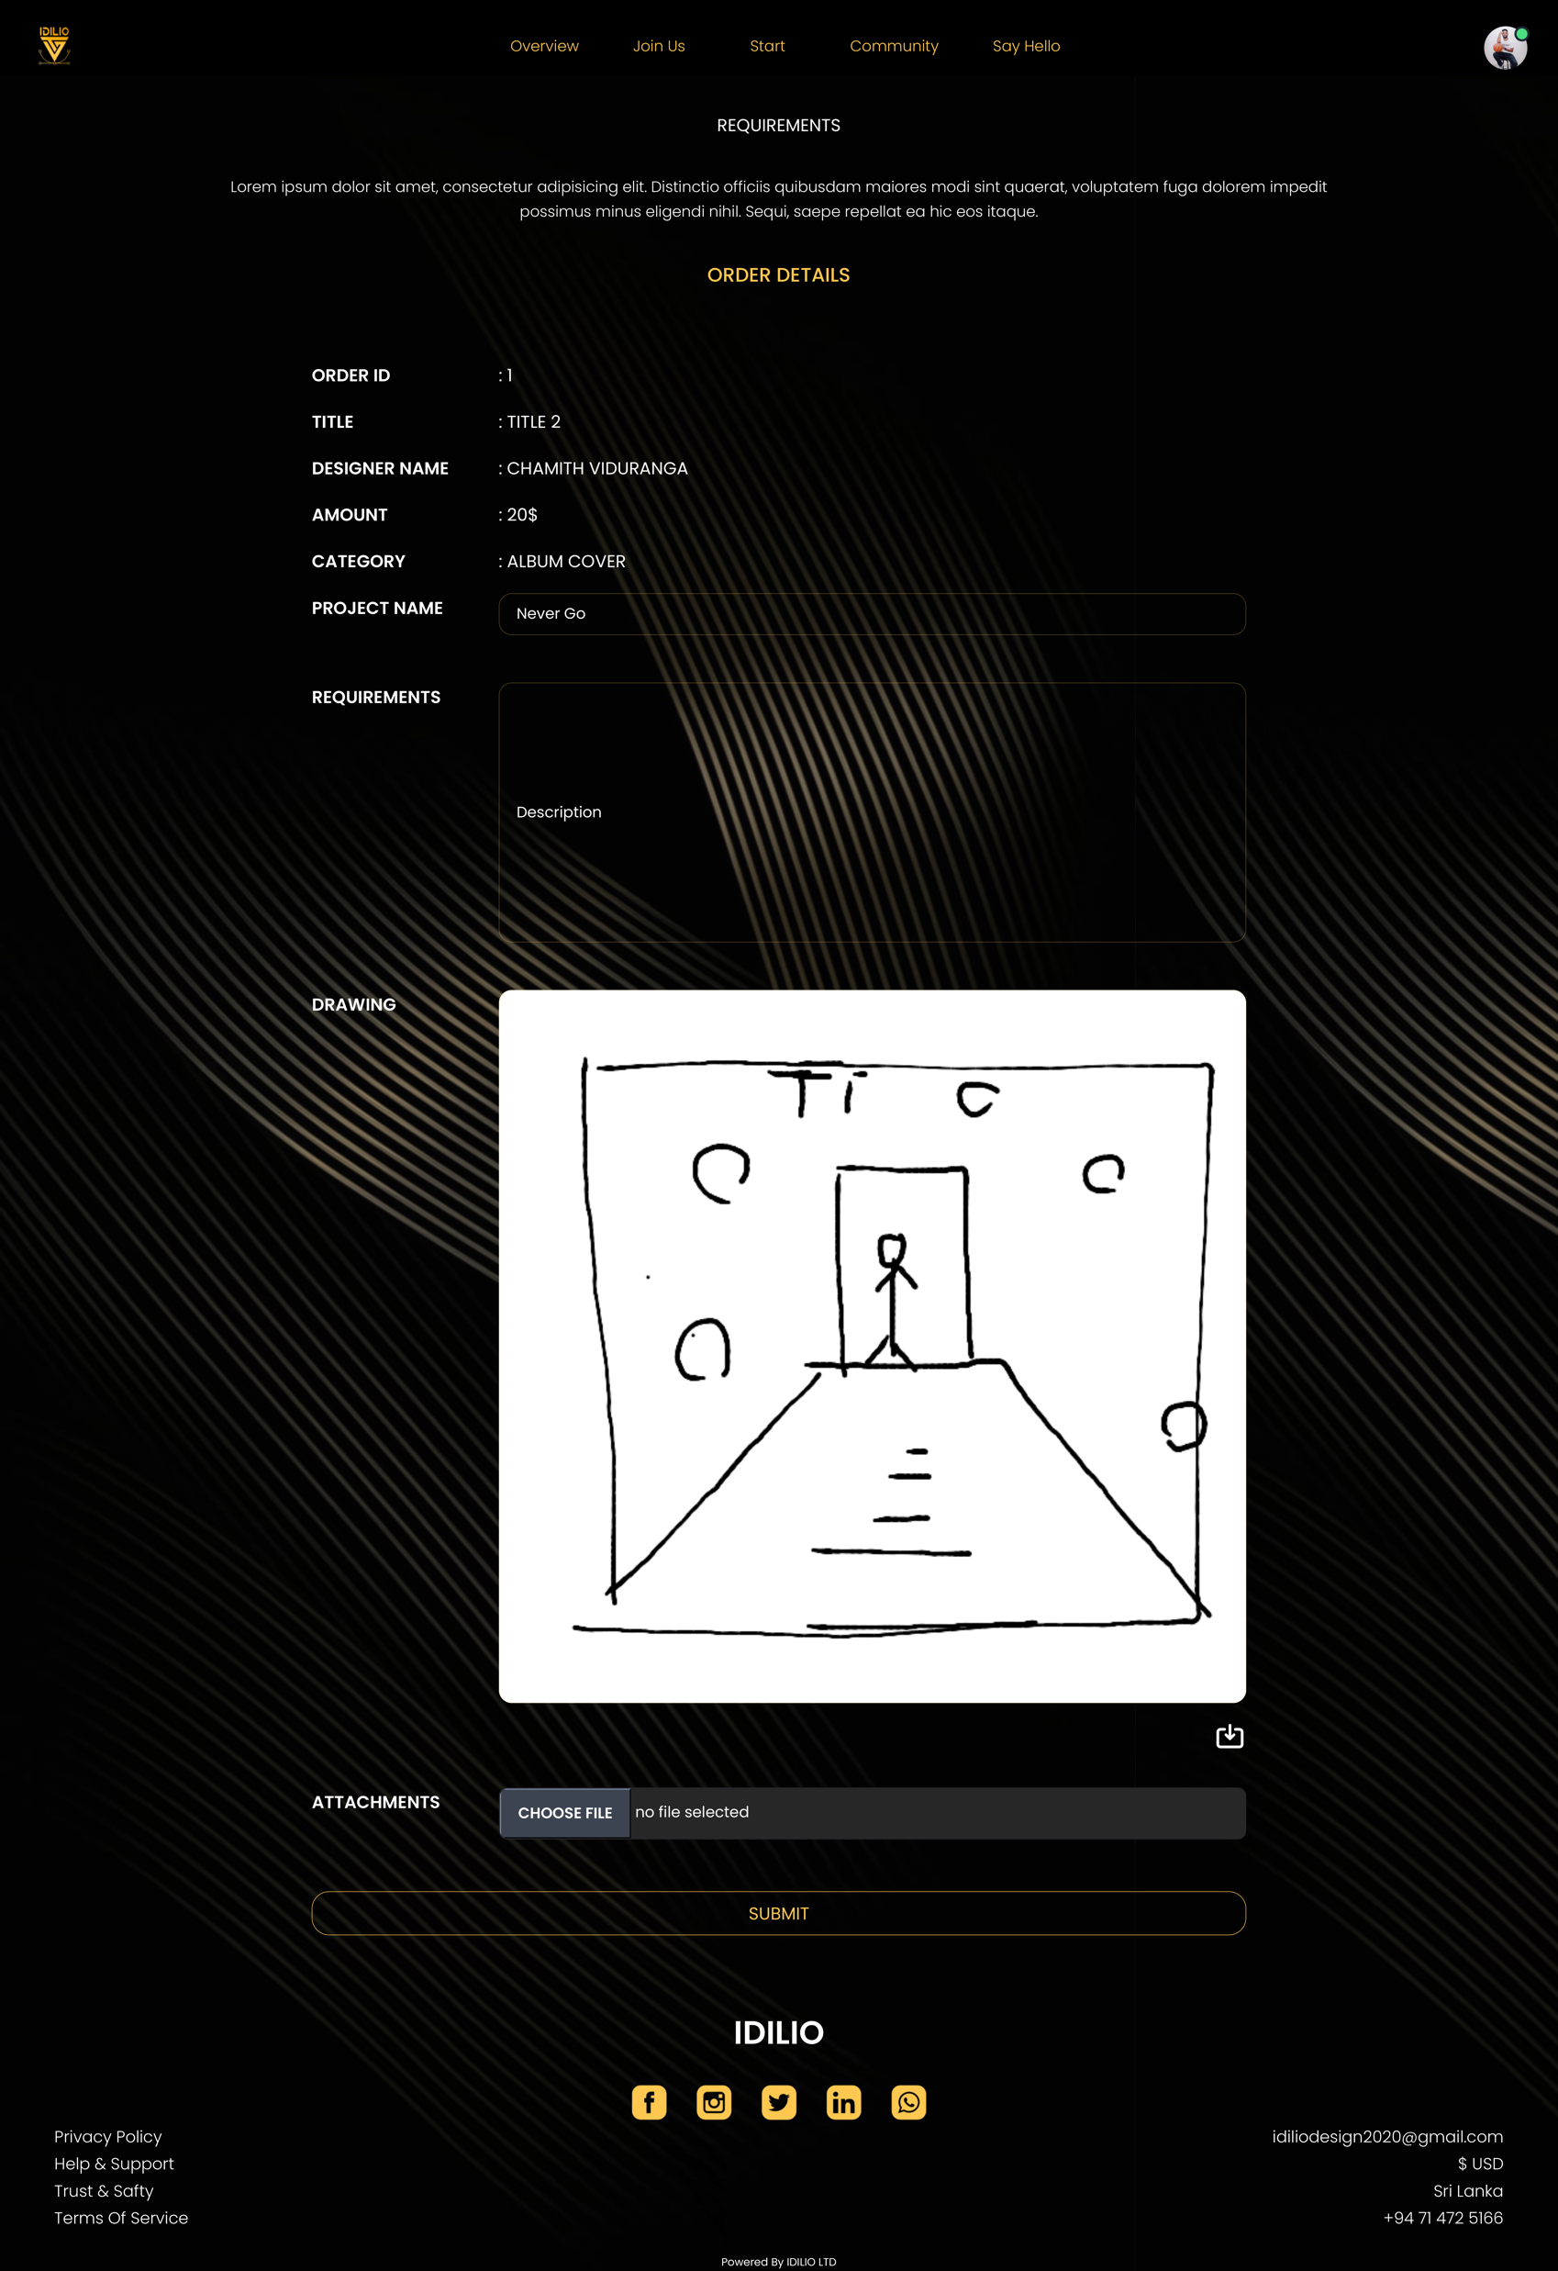
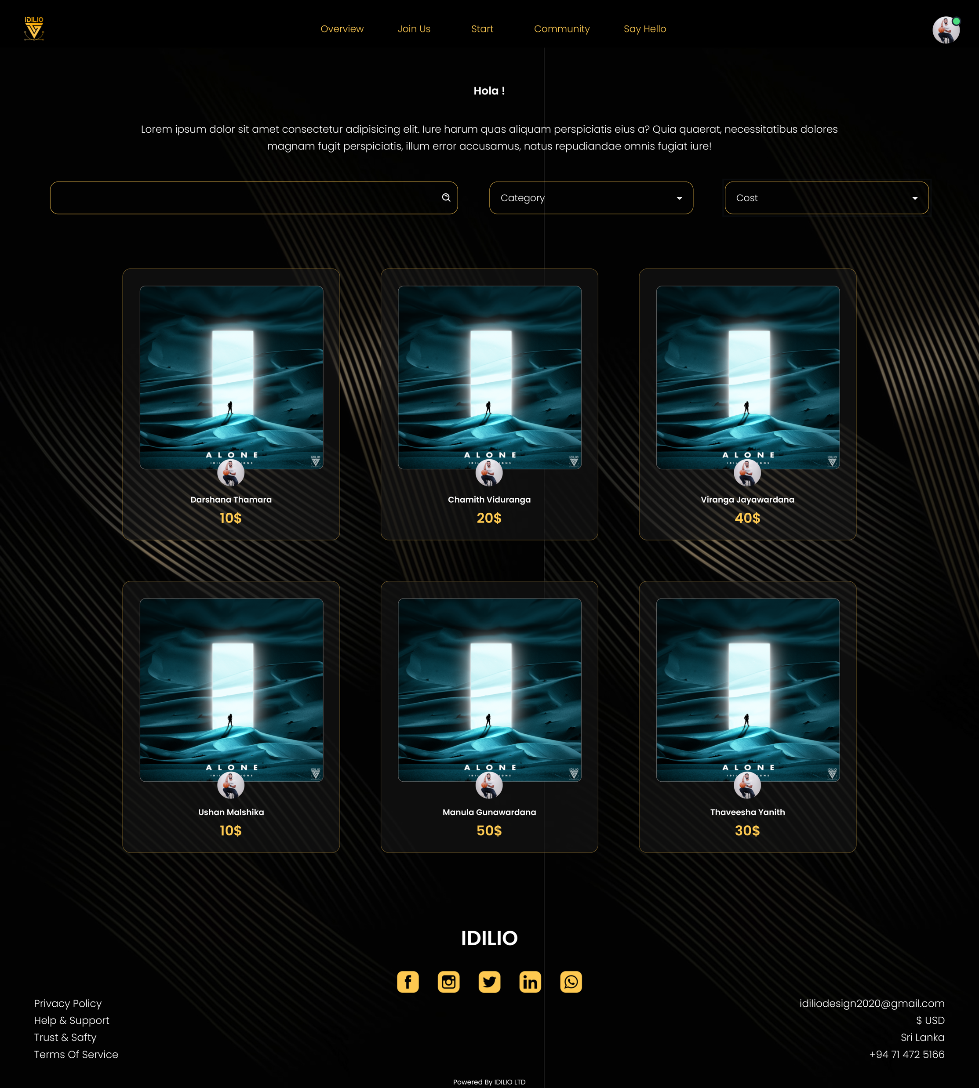
Progress
Frontend

Slide 9
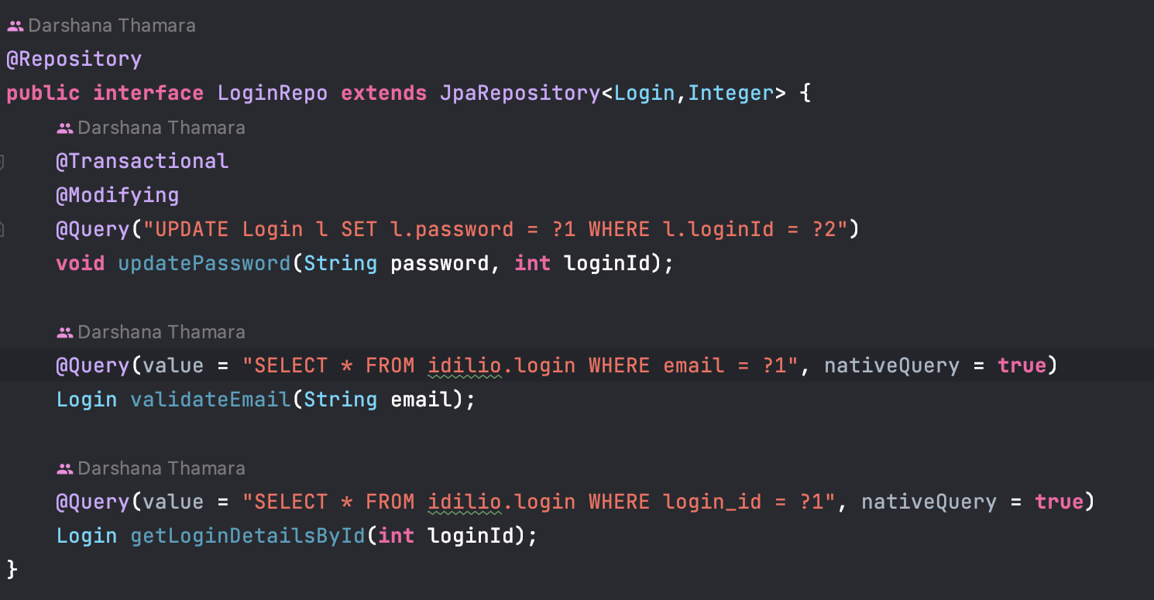
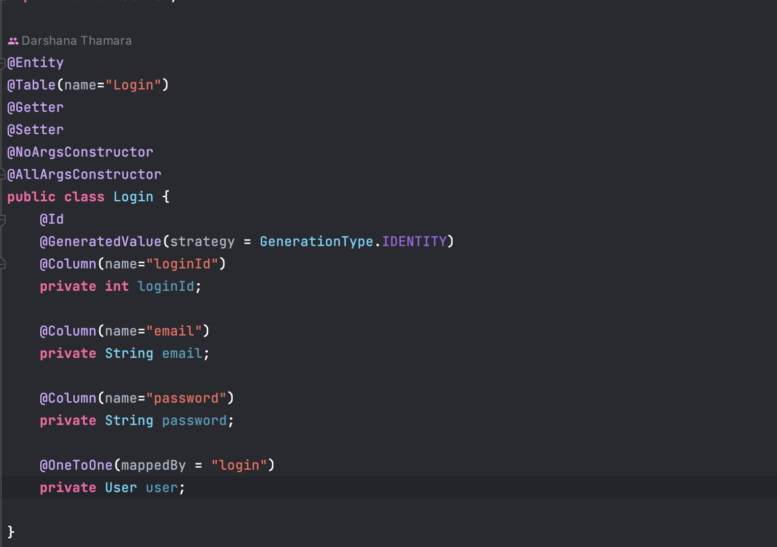
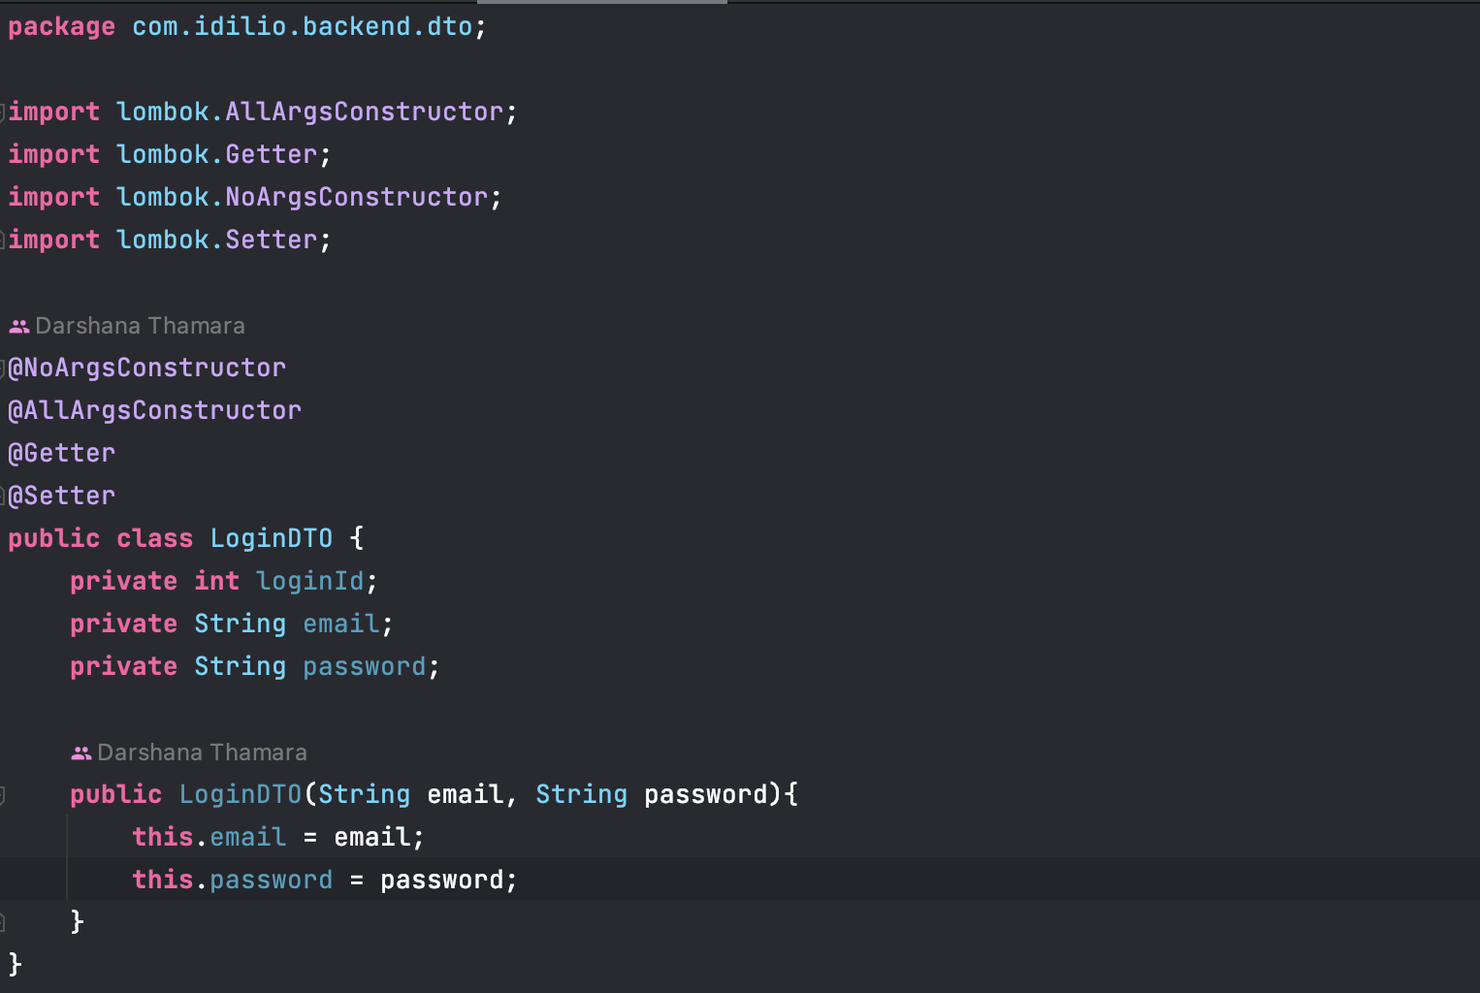
Backend
Repository
DTO
Model

Slide 10
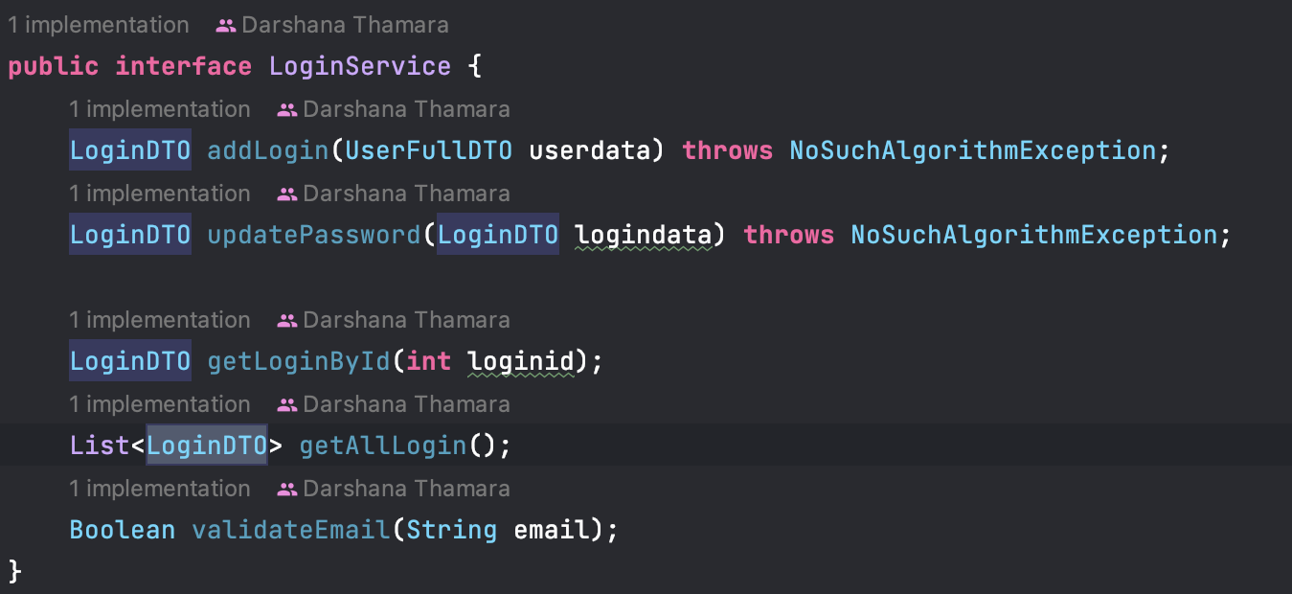
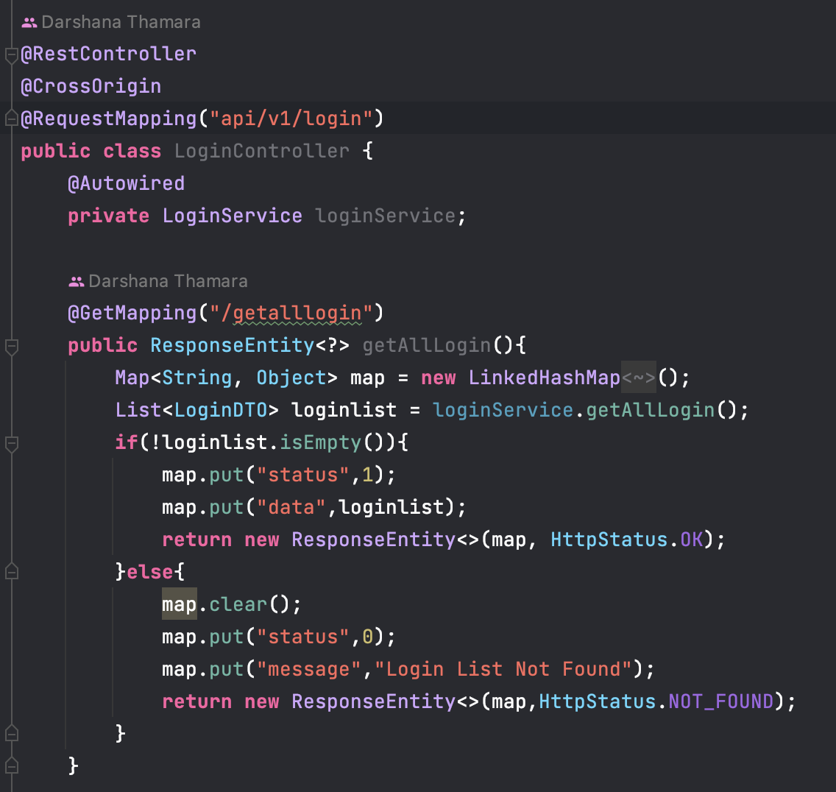
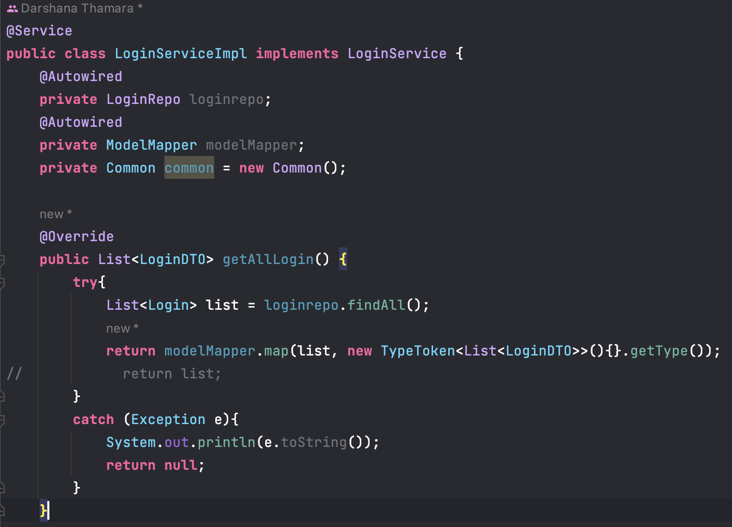
Service Interface
Controller
Service Implementation

Slide 11
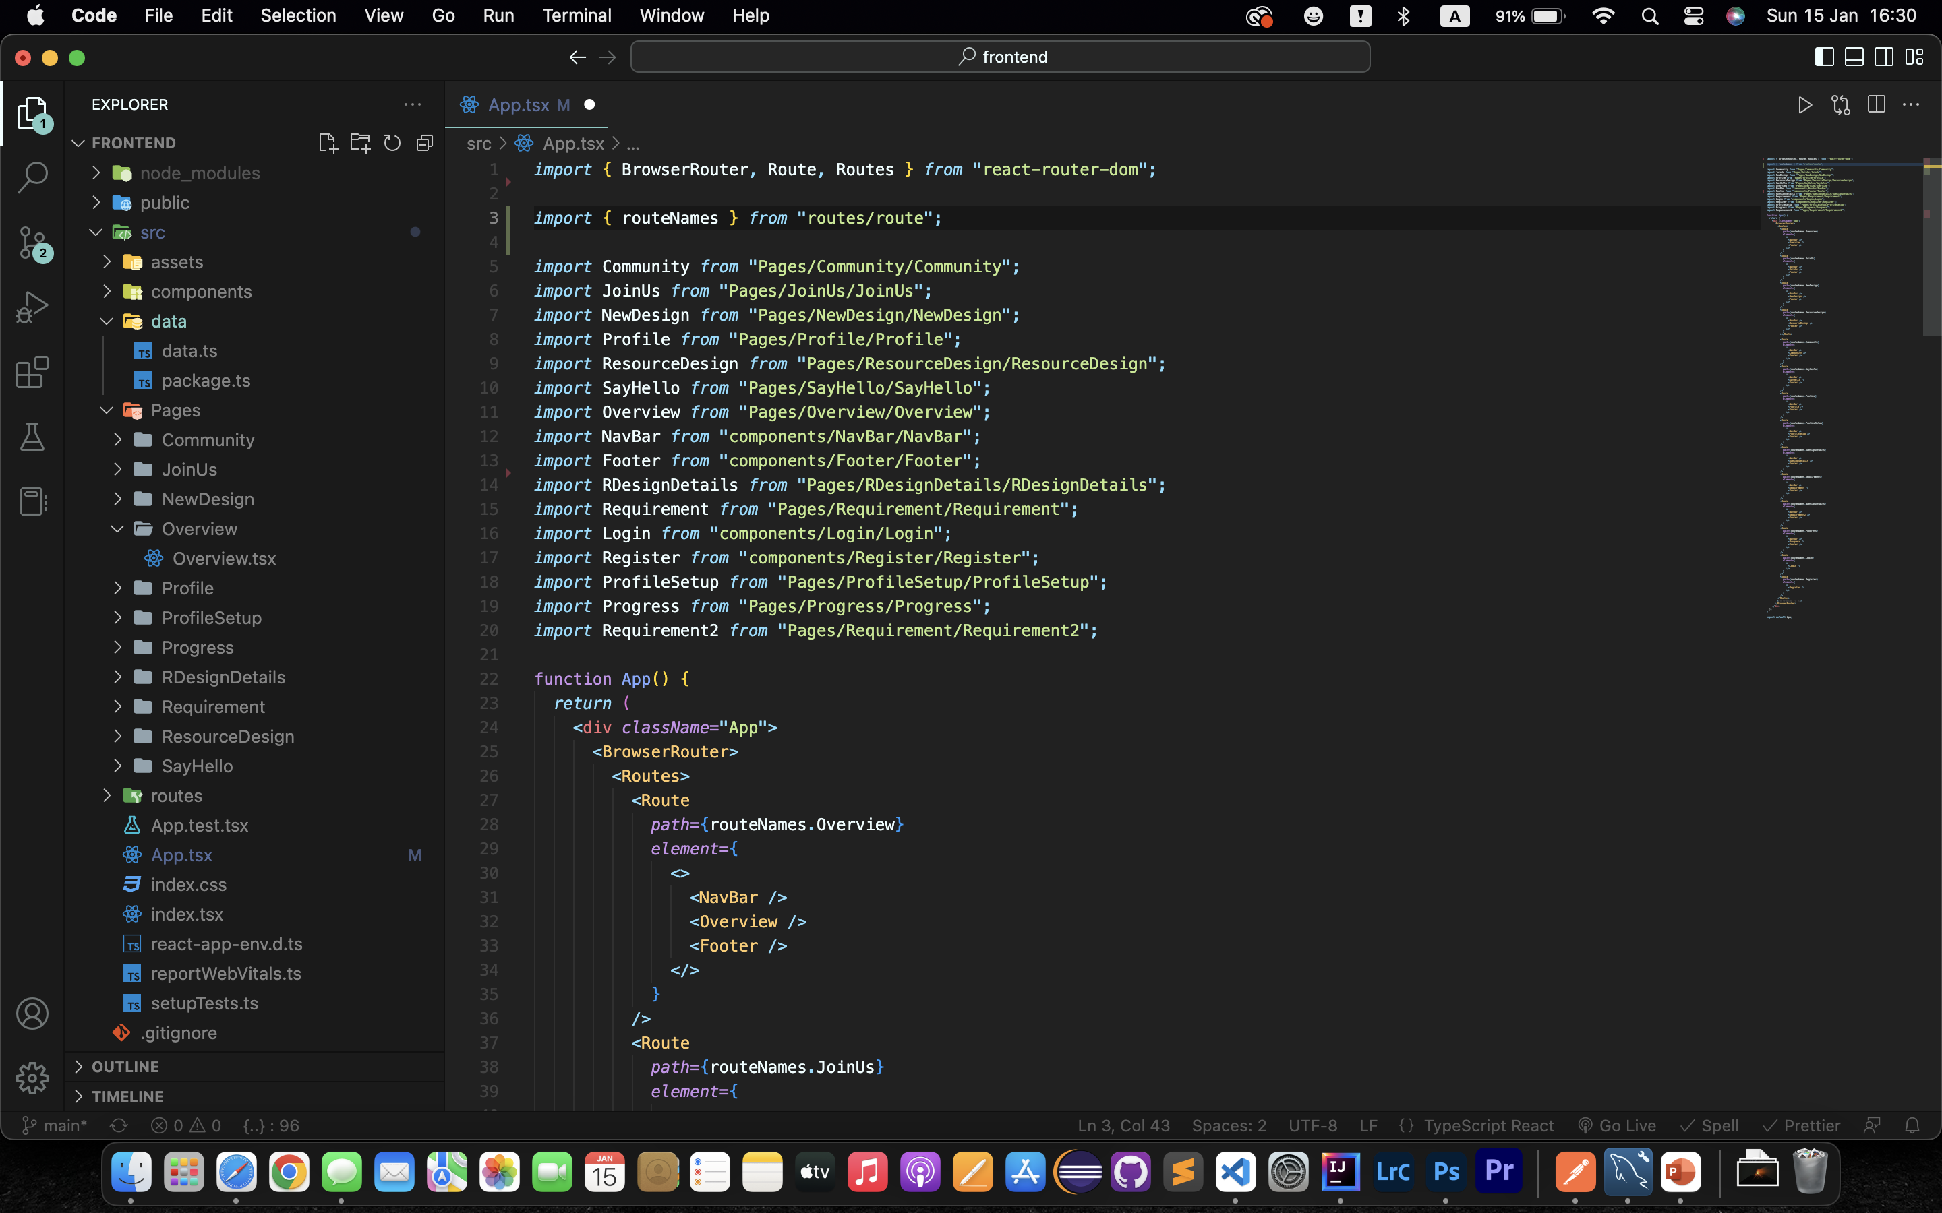
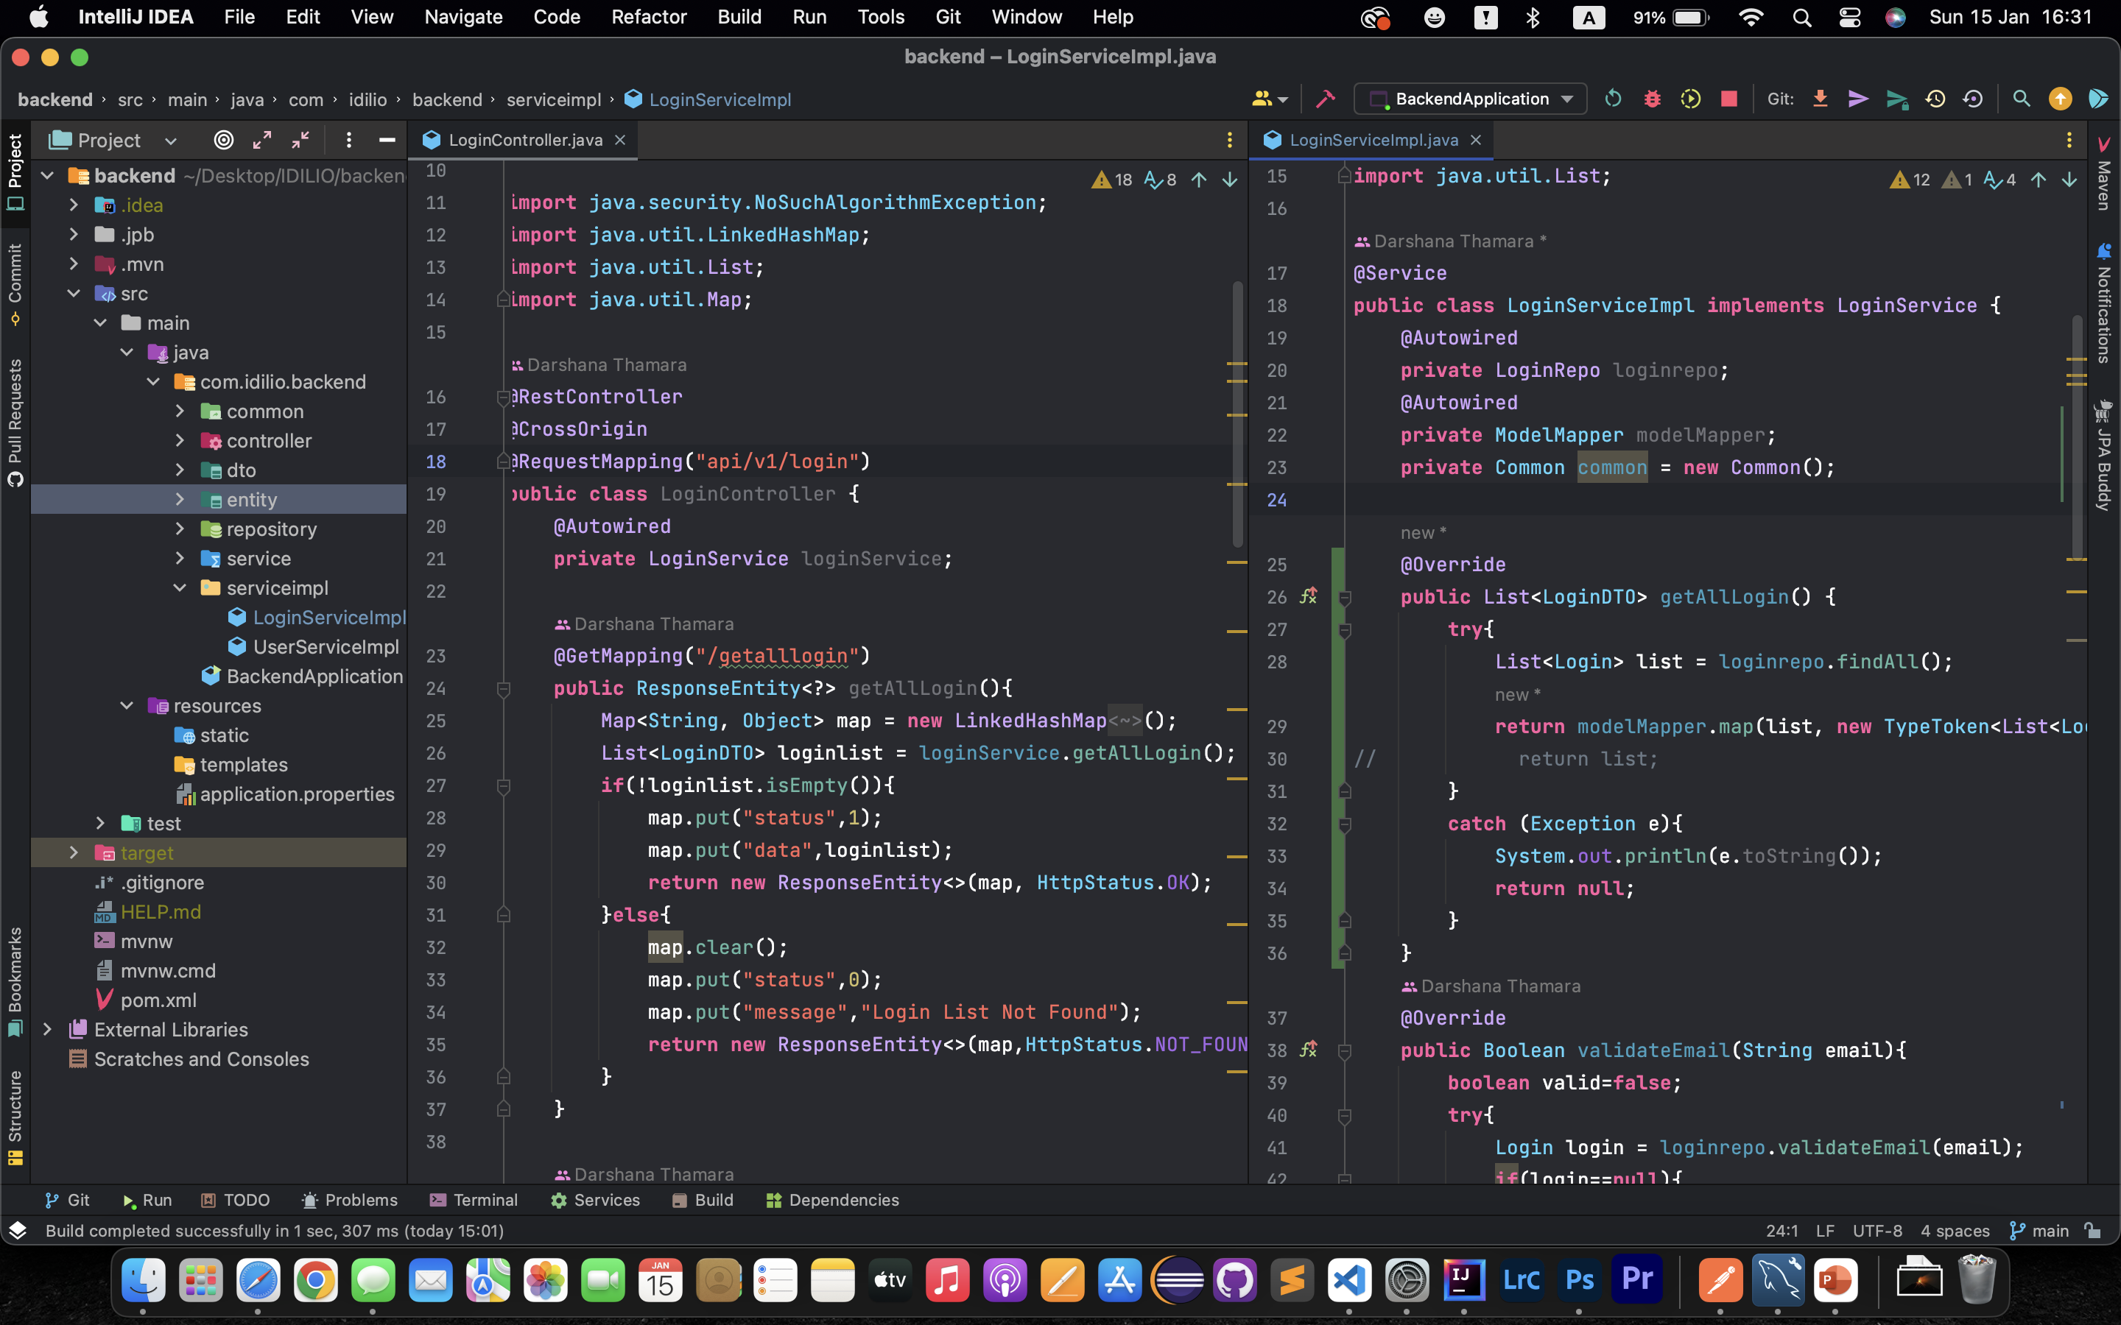
Appendix
Frontend Development : VS Code
Backend Development : IntelliJ IDEA

Slide 12
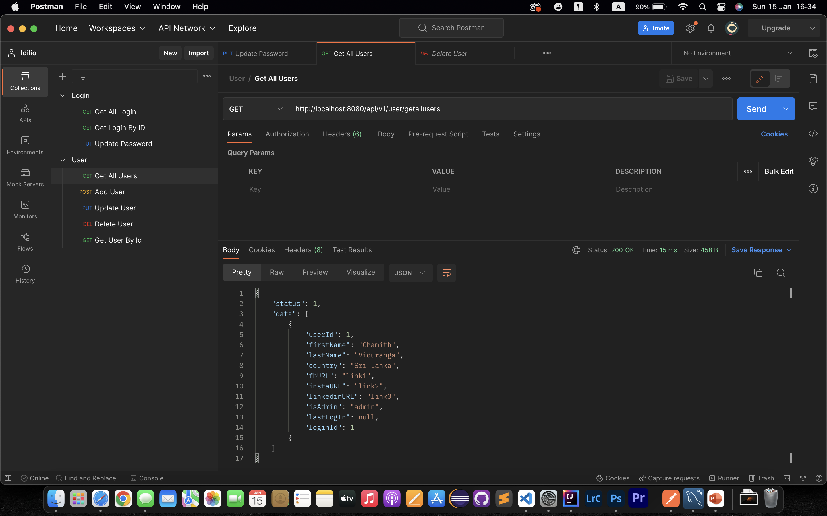
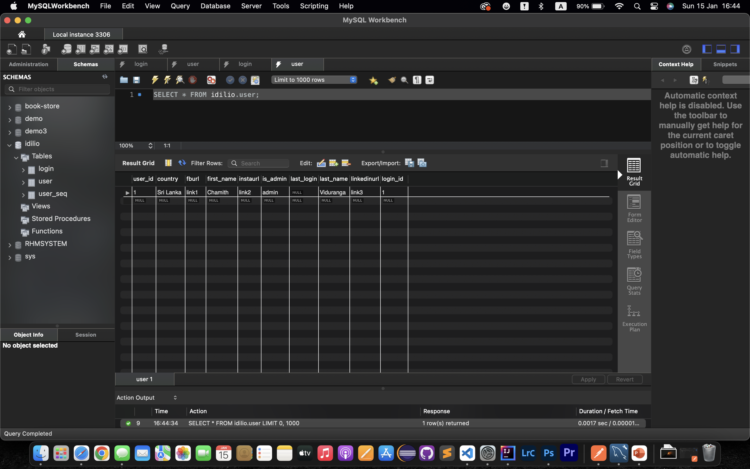
Api testing : Postman
Database Checking : MYSQL Workbench

